Slide 1
Team Team

Slide 2
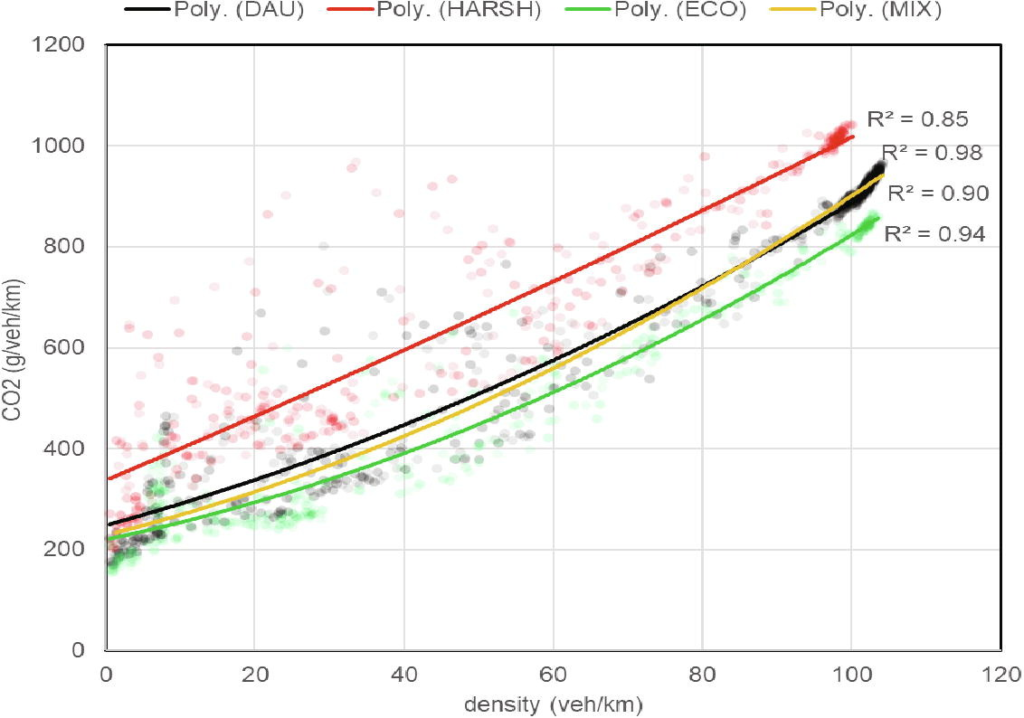
Aggressive driving causes emissions
(Adamidis et al. 2020)
Notes:
Research conducted by Emission Analytics shows that missions at high speed can peak at more than ten times typical levels of nitrogen oxides (NOx) pollutants. Aggressive driving increases NOx by up to five times on the motorway and 35% on rural roads. This is especially important in Hevs as calmer driving means more reliance on gasoline.

Slide 3


Slide 4

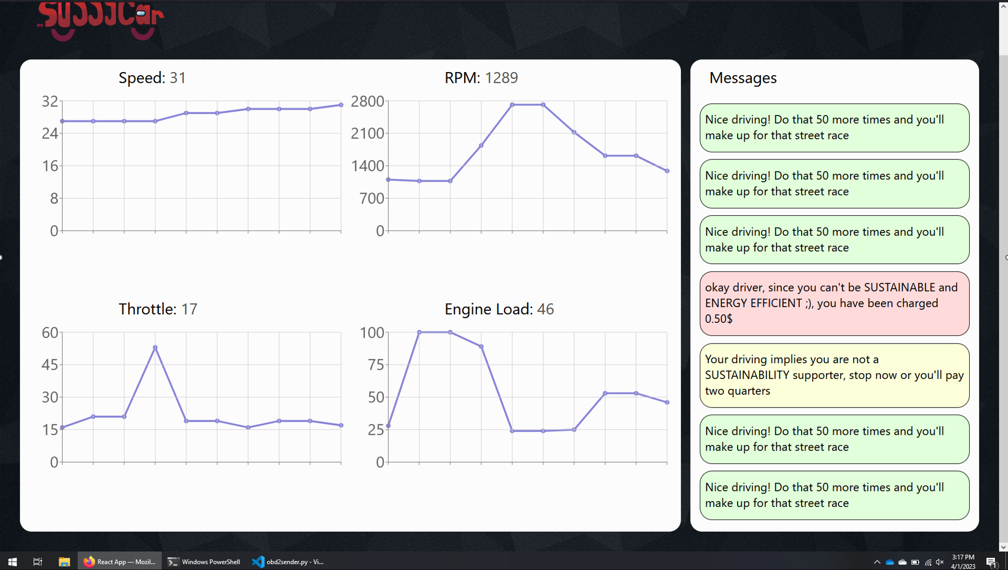
App view

Slide 5

Technologies

Slide 6

Future Improvements
-More sensor data
-Carpooling statistics
-Credentials / Login
-Integrating more payment methods
-Integrating a database to track driving performance over time
-Car will scream at you

Slide 7


Brought to you by the RIOT Robotics club (please join)

